Slide 1
Blockchain – Integration Abel Sanchez, John R. Williams
MIT | Cambridge, MA

Slide 2
DATA

Slide 3


Slide 4
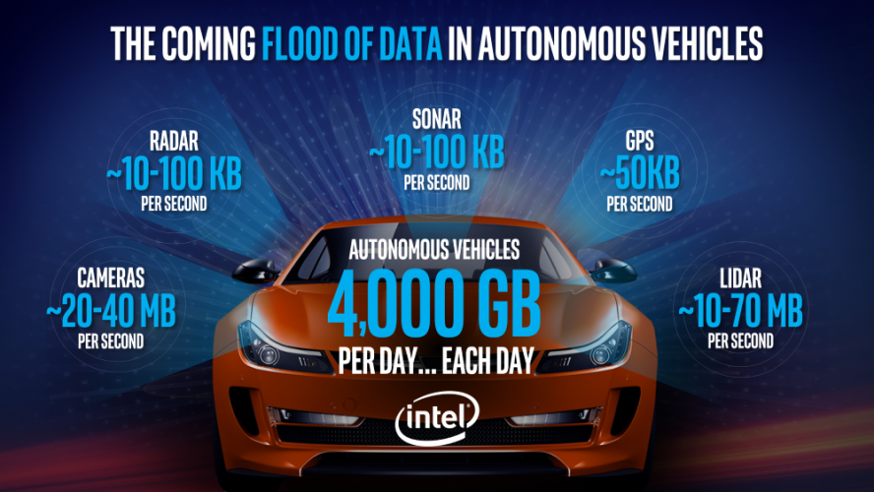

Slide 5

7 BILLION PEOPLE
195 COUNTRIES
ALL PRODUCING DATA

Slide 6
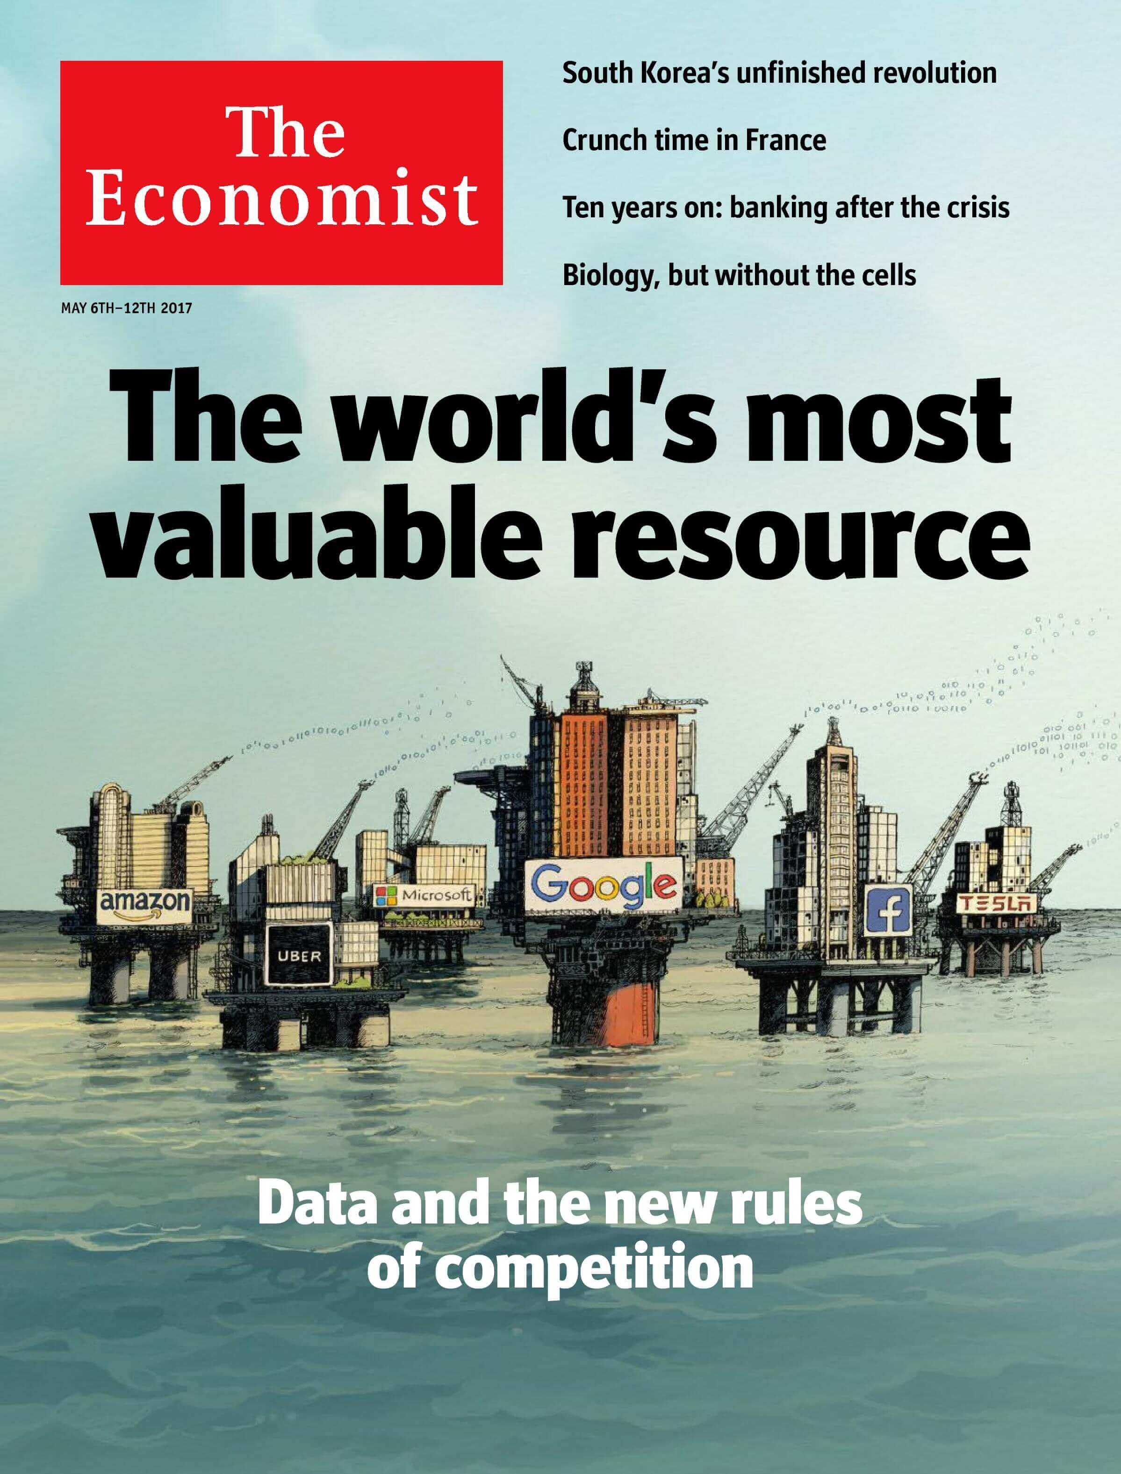
DATA
IS THE NEW OIL
We need to find it,
extract it, refine it,
store it, distribute it,
and monetize it.

Slide 7


Slide 8


Slide 9
What about?
Financial
Cultural
Travel
Education (how many?)
Weather
Social
Lodging
Government
Environment
Retail
Health
Energy
Transportation
Religion
Work
Content
Activity
Entertainment
Scientific

Slide 10
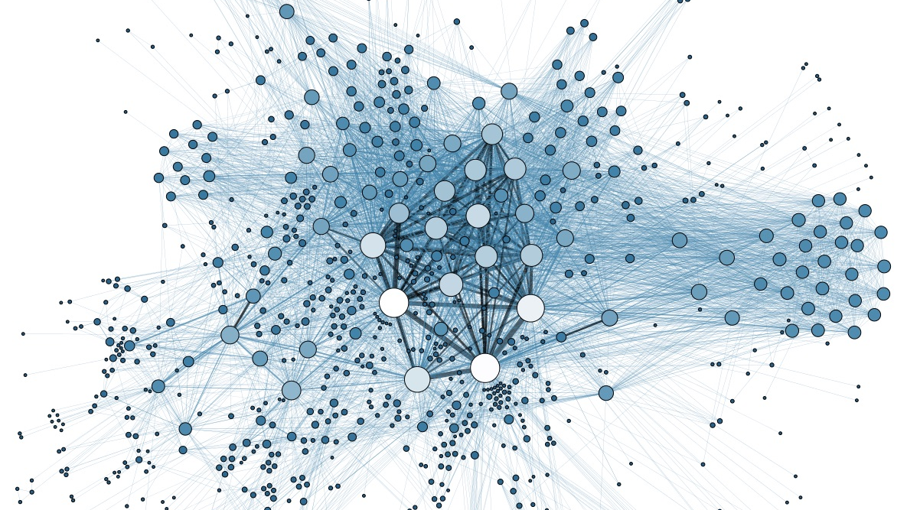

Slide 11

Silo-izing

Slide 12
Financial
Energy
Content
Environment
Cultural
Social
Activity
Religion
Retail
Travel
Entertainment
Lodging
Work
Education
Health
Scientific
Weather
Transportation
Government

Slide 13
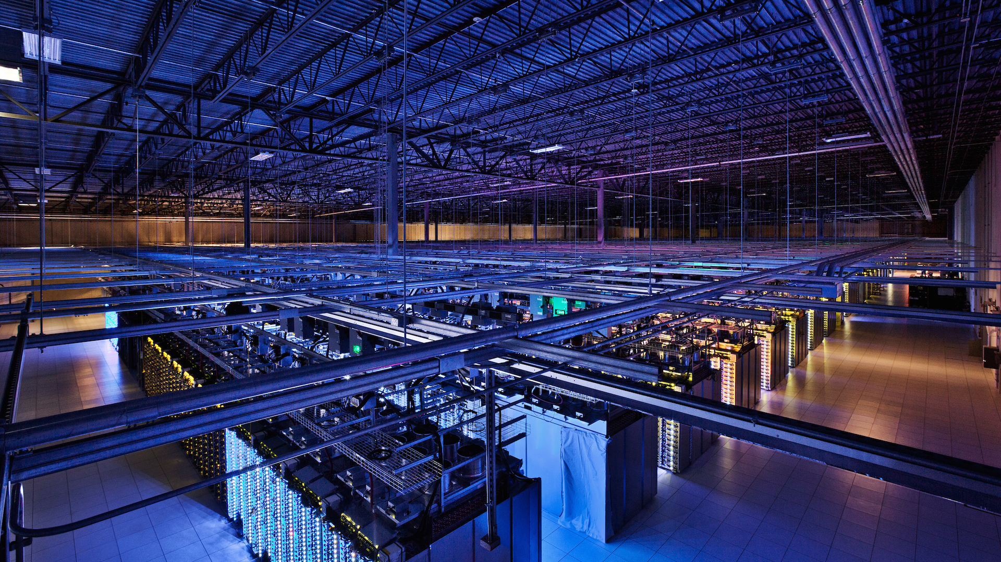
1000s of databases per corporation

Slide 14
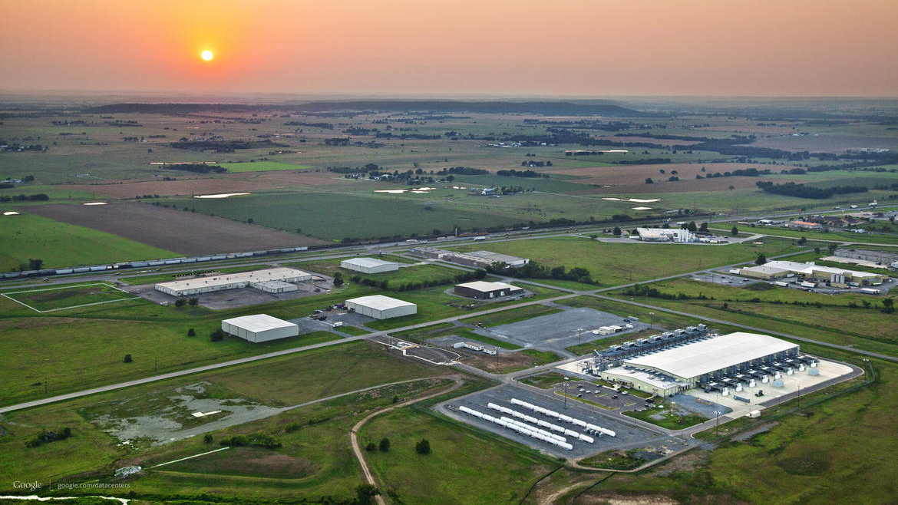

Slide 15


Slide 16
1980: Data Integration

Slide 17


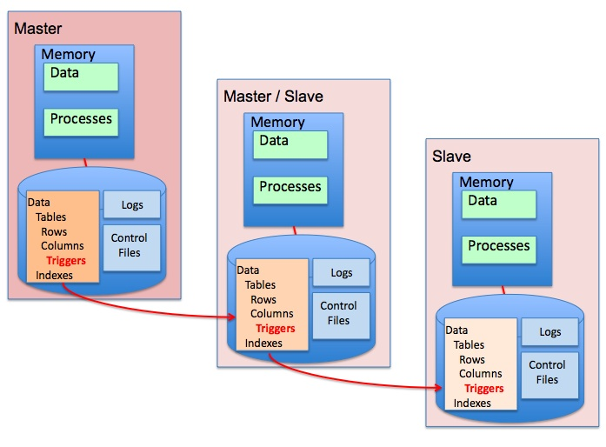


Common Database
Business
Process
Not shared:
Application contracts
Data formats
Business processes
Business
Process
Business
Process

Slide 18





data
Standardization / mapping
integration
EDI
Order
Inventory
Etc.
Not shared:
Application contracts
Data formats
Business processes
Order
Inventory
Etc.
data
Standardization / mapping
integration

Slide 19
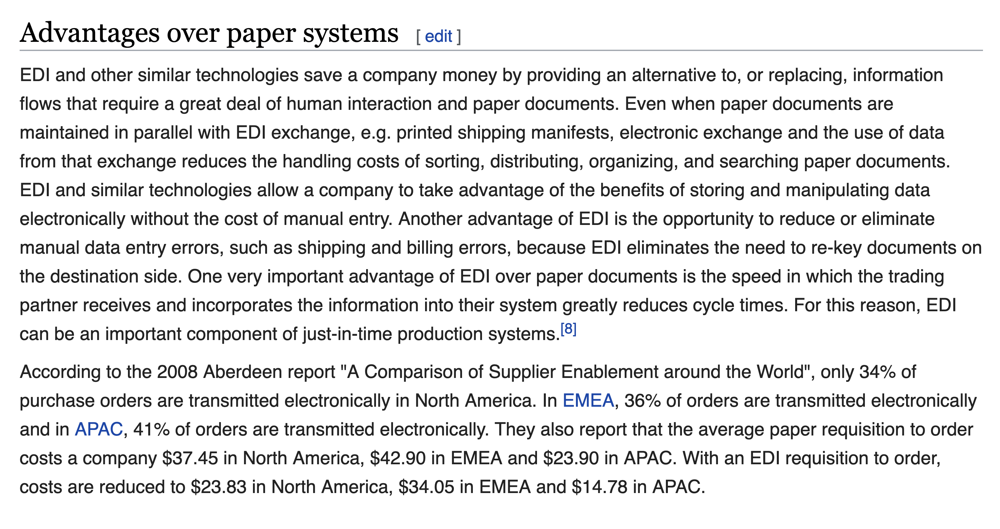
https://en.wikipedia.org/wiki/Electronic_data_interchange#Advantages_over_paper_systems

Slide 20
1990: FUNCTIONALITY Integration

Slide 21
Application
Interfaces
Domain
Interfaces
Common
Facilities
Object Request Broker (ORB)
Object
Services

Slide 22
2000: Service Integration

Slide 23

SOA
Service Oriented Architecture
Service Registry
WSDL
WSDL
SOAP Messages
Service Provider
Service Consumer

Slide 24
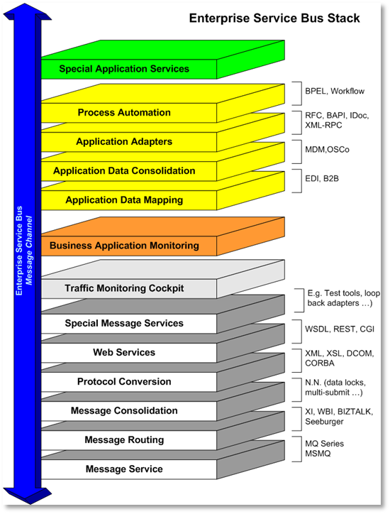
ESB
Enterprise Service Bus
https://en.wikipedia.org/wiki/Enterprise_service_bus

Slide 25
2010: Microservices Integration

Slide 26


Not shared:
Business processes
Remote state
SOA → REST
Representational State Transfer
Contract
JSON
Organization A
Organization B
Contract
Business Process
Business Process

Slide 27
2020: Blockchain Integration

Slide 28
Integration Evolution
Data Integration | Functionality Integration | Service Integration | Microservice Integration | Blockchain Integration
1980s | 1990s | 2000s | 2010s | 2020s
File Transfer Common Database Electronic Data Interchange(EDI) | Remote Procedure Call (RPC) Object Request Broker (ORB) Message Oriented Middleware (MOM) | Web Services (WS) Enterprise Service Bus (ESB) Business Process Manager (BPM, integrating application software tasks) | Representational State Transfer (REST) Cloud Computing | Cryptography Distributed Ledger Smart Contract
Not Real-Time Batch Jobs Extract Transform Load (ETL) | Real-Time Client server Guaranteed Delivery (MOM) | Contract Formalization API Definition Process Modeling | Real-Time Web Scale XaaS | Decentralization Distributed Business Process Shared Data

Slide 29


BLOCKCHAIN
System A
Node
Node
System B
Business Process
Smart Contract X
Smart Contract X
Business Process
Database A
Ledger X
Ledger X
Database B
Node
Node
Node
Node

Slide 30
Shared Logic and Data
Organization A System A | Data | Business Process
Contract
Protocol
Contract
Business Process | Data | Organization B System B
1980s File
2000s Web Services
2020 Blockchain

Slide 31
Shared Integration Infrastructure
Shared Data
Distributed Ledger
Shared Business Processes
Smart Contract
Contract
SOAP
Protocol
FTP

Slide 33
Data Integration | Functionality Integration | Service Integration | Microservice Integration | Blockchain Integration
1980s | 1990s | 2000s | 2010s | 2020s
File Transfer Common Database Electronic Data Interchange(EDI) | Remote Procedure Call (RPC) Object Request Broker (ORB) Message Oriented Middleware (MOM) | Web Services (WS) Enterprise Service Bus (ESB) Business Process Manager (BPM, integrating application software tasks) | Representational State Transfer (REST) Cloud Computing | Cryptography Distributed Ledger Smart Contract
Not Real-Time Batch Jobs Extract Transform Load (ETL) | Real-Time Client server Guaranteed Delivery (MOM) | Contract Formalization API Definition Process Modeling | Real-Time Web Scale XaaS | Decentralization Distributed Business Process Shared Data
First widely adopted data integration. Many challenges. | Language dependent, platform dependent, OS dependent, limitations of shared context. Attempts as interfaces (IDL). | Web standards, XML. Common message format SOAP, interfaces WSDL. Coupled with ESB, BPM, enable business integration semantics. | Lower cost validation and APIs. Distributed system decomposition. | Share business processes as smart contracts. The validate the contract, the state is validated through the blockchain state – including multiparty.
 | Data is agnostic, no inspection, validation, transformation. No understanding of business process | Overspecification, WS-*, too much complexity | Enabled by cloud, web scale | ESB/BPM spanning multiple organizations

Slide 34
Industry Verticals
Industries where that have understanding of data models and business processes
Examples:
Healthcare
Transportation
Supply Chain

Slide 35
The cost of agreement
20 years for UPC adoption
The brilliance of the web simplicity

